Slide 1
Operating Systems
Unit I
Srinivas Koppu
Asst.Professor
SITE
Notes:
VIT University

Slide 2
Roadmap
Overview: Role and purpose of operating systems; history of operating system development; functionality of a typical operating system; design issues ( efficiency , robustness, flexibility, portability, security, compatibility).
Basic principles: Structuring methods; abstractions, processes, and resources; design of application Programming interfaces (APIs); device organization; interrupts; user/system state transitions.
Text Books:
Abraham Silberschatz, Peter Baer Galvin and Greg Gagne, “Operating System Concepts Sixth Edition”, John Wiley & Sons (ASIA) Pvt. Ltd, 2005.
William Stallings, “Operating System”, Prentice Hall of India, 4th Edition, 2003/2005.
Andrew S. Tanenbaum, “Modern Operating Systems”, Prentice Hall of India Pvt. Ltd, 2003

Slide 3
Expected Outcome:
An ability to apply knowledge of mathematics, science, computing and information technology appropriate to the discipline
An ability to design, implement and evaluate a computer-based system, process, component, or program to meet desired needs.
Recognition of the need for and an ability to engage in continuing.
An ability to use and apply current technical concepts and practices in the core information technologies.
An ability to effectively integrate IT-based solutions into the user environment.

Slide 4
What is an Operating System?
A program that acts as an intermediary between a user of a computer and the computer hardware.
OR
A program that controls the execution of application programs.
Kernel – the one program running at all times (all else being application programs).
OR
Resource allocator – manages and allocates resources.
An interface between applications and hardware.
Notes:
VIT University

Slide 5
Main objectives of an OS:
Convenience
  Make the computer system convenient to use.
Efficiency
  An OS allows the computer system resources to be used in an efficient manner
Ability to evolve
  An OS should be constructed in such a way as to permit the effective development, testing, and introduction of new system functions without interfering with service.
Notes:
VIT University

Slide 6

Abstract View of System Components
Notes:
VIT University

Slide 7
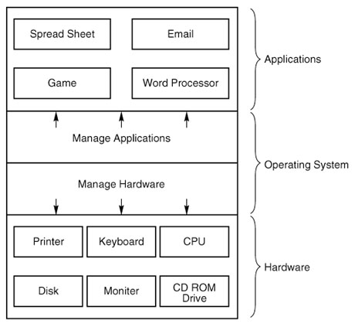
Computer system components

Slide 8
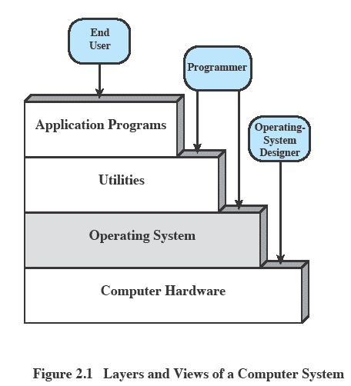
Layers and Views
Notes:
The hardware and software used in providing applications to a user can be viewed in a layered or hierarchical fashion, as depicted here.
The user of those applications, the end user, generally is not concerned with the details of computer hardware.
The end user views a computer system in terms of a set of applications.
An application can be expressed in a programming language and is developed by an application programmer.
If one were to develop an application program as a set of machine instructions that is completely responsible for controlling the computer hardware, one would be faced with an overwhelmingly complex undertaking.
The most important collection of system programs comprises the OS.
The OS masks the details of the hardware from the programmer and provides the programmer with a convenient interface for using the system.
It acts as mediator, making it easier for the programmer and for application programs to access and use those facilities and services.

Slide 9
Layers and Views Conti…
The user of those applications, the end user, generally is not concerned with the details of computer hardware.
  The end user views a computer system in terms of a set of applications.
  An application can be expressed in a programming language and is developed by an application programmer.
If one were to develop an application program as a set of machine instructions that is completely responsible for controlling the computer hardware, one would be faced with an overwhelmingly complex undertaking.
The most important collection of system programs comprises the OS.
  The OS masks the details of the hardware from the programmer and provides the programmer with a convenient interface for using the system.
  It acts as mediator, making it easier for the programmer and for application programs to access and use those facilities and services.

Slide 10
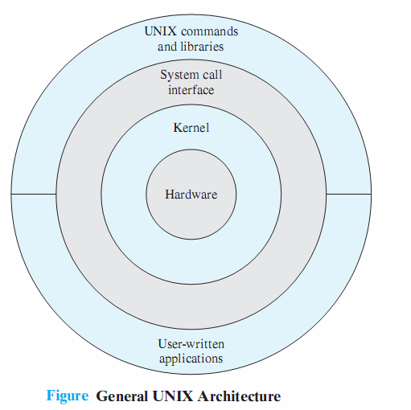
Unix Architecture
Notes:
VIT University

Slide 11
Computer Startup
bootstrap program is loaded at power-up or reboot
  Typically stored in ROM or EPROM, generally known as firmware
  Initializates all aspects of system
  Loads operating system .kernel and starts execution

Slide 12
Services Provided by the Operating System
Program development.(Editors and debuggers)
  The OS provides a variety of facilities and services, such as editors and debuggers, to assist the programmer in creating programs.
  Typically, these services are in the form of utility programs that, while not strictly part of the core of the OS, are supplied with the OS and are referred to as application program development tools.
Program execution.
  OS handles scheduling of numerous tasks required to execute a program.
Notes:
VIT University

Slide 13
Services Conti…
Access I/O devices
  Each device will have unique interface
  OS presents standard interface to users
Controlled access to files
  Accessing different media but presenting a common interface to users.
  Provides protection in multi-access systems

Slide 14
Services Conti…
System Access
    Controls access to the system and its resources
Error detection and response
  Internal and external hardware errors
  Software errors
  Operating system cannot grant request of application
Accounting
  Collect usage statistics
  Monitor performance
Notes:
VIT University

Slide 15
The Role of an OS
A computer is a set of resources for the movement, storage, and processing of data.
The OS is responsible for managing these resources.
Operating System as Software
The OS functions in the same way as an ordinary computer software
  It is a program that is executed by the CPU
  Operating system relinquishes control of the processor
Notes:
VIT University

Slide 16
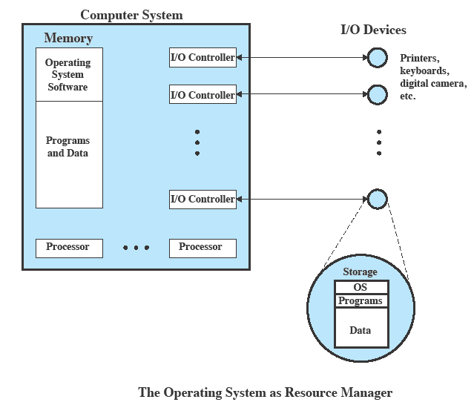
OS as Resource Manager
Notes:
VIT University

Slide 17
OS as Resource Manager Conti…
A portion of the OS is in main memory.
  This includes the kernel, or nucleus, which contains the most frequently used functions in the OS
  and other portions of the OS currently in use.
The remainder of main memory contains user programs and data.
  The allocation of this resource (main memory) is controlled jointly by the OS and memory management hardware in the processor.

Slide 18
OS as Resource Manager Conti…
The OS decides when an I/O device can be used by a program in execution and controls access to and use of files.
The processor itself is a resource, and the OS must determine how much processor time is to be devoted to the execution of a particular user program.
  In the case of a multiple-processor system, this decision must span all of the processors.

Slide 19
Evolution of Operating Systems
Operating systems will evolve over time
  Hardware upgrades plus new types of hardware
    Example: Early versions of UNIX and the Macintosh operating system did not employ a paging mechanism because they were run on processors without paging hardware
  New services (user demand or in response to the needs of system managers)
    Example: if it is found to be difficult to maintain good performance for users with existing tools, new measurement and control tools may be added to the OS.s
  Fixes
    These are discovered over the course of time and fixes are made.
    Of course, the fix may introduce new faults.
Notes:
VIT University

Slide 20
Evolution Stages include:
  Serial Processing
  Simple Batch Systems
  Uni programming
  Multi programmed batch systems
  Time Sharing Systems
  Mainframe Systems
  Desktop Systems
  Multiprocessor Systems
  Distributed Systems
  Clustered System
  Real -Time Systems
  Handheld Systems
  Computing Environments
Notes:
VIT University

Slide 21
Operating system timeline
First generation: 1945 – 1955
  Vacuum tubes
  Plug boards
Second generation: 1955 – 1965
  Transistors
  Batch systems
Third generation: 1965 – 1980 (IBM360)
  Integrated circuits
  Multiprogramming
Fourth generation: 1980 – present
  Large scale integration
  Personal computers
Next generation: ???
  Systems connected by high-speed networks?
  Wide area resource management?

Slide 22
Serial Processing
No operating system
Machines run from a console with display lights, toggle switches, input device, and printer.
Example:If an error halted the program, the error condition was indicated by the lights.
  If the program proceeded to a normal completion, the output appeared on the printer.
These early systems presented two main problems:
  Scheduling:
  Setup time:
Notes:
VIT University

Slide 23
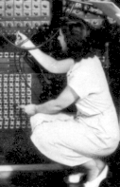
Serial Processing
What did the first operating system look like?
1945 to 1955
No operating system
human operators

Slide 24
Problems include:
Scheduling
  Most installations used a hardcopy sign-up sheet to reserve computer time.
  Typically, a user could sign up for a block of time in multiples of a half hour or so.
  A user might sign up for an hour and finish in 45 minutes; this would result in wasted computer processing time.
  On the other hand, the user might run into problems, not finish in the allotted time, and be forced to stop before resolving the problem.

Slide 25
Problems include Conti….
Setup time:
  A single program, called a job, could involve loading the compiler plus the high-level language program (source program) into memory, saving the compiled program (object program) and then loading and linking together the object program and common functions.
  Each of these steps could involve mounting or dismounting tapes or setting up card decks.
  If an error occurred, the hapless user typically had to go back to the beginning of the setup sequence.
  Thus, a considerable amount of time was spent just in setting up the program to run.

Slide 26
Simple batch system
Early computers were extremely expensive
  Important to maximize processor utilization.
    The wasted time due to scheduling and setup time was unacceptable.
Monitor (With this type of OS, The user no longer has direct access to the processor.)
  Software that controls the sequence of events.
  Batch jobs together.
    Instead, the user submits the job on cards or tape to a computer operator, who batches the jobs together sequentially and places the entire batch on an input device, for use by the monitor.
    Each program is constructed to branch back to the monitor when it completes processing, (Program returns control to monitor when finished) at which point the monitor automatically begins loading the next program
Notes:
VIT University

Slide 27
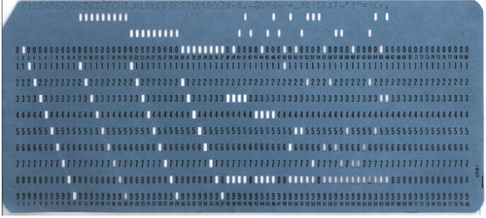
Punched Card

Slide 28
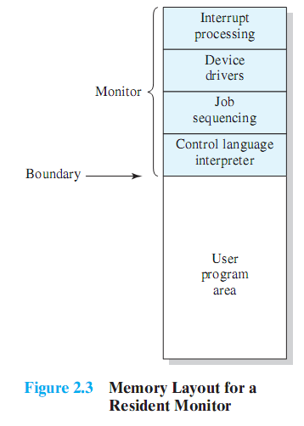
Monitor’s perspective
Monitor controls the sequence of events.
Resident Monitor is software always in memory
Monitor reads in job and gives control
Job returns control to monitor
Notes:
Monitor point of view: The monitor controls the sequence of events.
Much of the monitor must always be in main memory and available for execution (Figure 2.3).
That portion is referred to as the resident monitor.
The rest of the monitor consists of utilities and common functions that are loaded as subroutines to the user program at the beginning of any job that requires them.
The monitor reads in jobs one at a time from the input device
As it is read in, the current job is placed in the user program area, and control is passed to this job.
When the job is completed, it returns control to the monitor, which immediately reads in the next job.
The results of each job are sent to an output device, such as a printer, for delivery to the user.

Slide 29
Job Control Language
Special type of programming language to control jobs .
Provides instruction to the monitor.
  What compiler to use
  What data to use
The monitor performs a scheduling function:
  A batch of jobs is queued up, and jobs are executed as rapidly as possible, with no intervening idle time.
  The monitor improves job setup time as well.
Notes:
The monitor performs a scheduling function:
A batch of jobs is queued up, and jobs are executed as rapidly as possible, with no intervening idle time.
The monitor improves job setup time as well.
With each job, instructions are included in a primitive form of job control language (JCL).
A special type of programming language used to provide instructions to the monitor.

Slide 30

Second generation: batch systems
a. Bring cards to IBM1401
b. Read cards onto input tape
c. Put input tape on IBM7094
d. Perform the computation, writing results to output tape
E & f. Put output tape on 1401, which prints output

Slide 31
Structure of a typical 2nd generation job
Data for
program
$END
FORTRAN
program
$RUN
$LOAD
$FORTRAN
$JOB, 10,6610802, ETHAN MILLER

Slide 32
Spooling(simultaneous peripheral operation on-line )
Original batch systems used tape drives
Later batch systems used disks for buffering
  Operator read cards onto disk attached to the computer
  Computer read jobs from disk
  Computer wrote job results to disk
  Operator directed that job results be printed from disk
Disks enabled simultaneous peripheral operation on-line (spooling)
  Computer overlapped I/O of one job with execution of another
  Better utilization of the expensive CPU
  Still only one job active at any given time

Slide 33
Batch Systems - Issues
  Solutions to speed up I/O:
  Offline Processing
    load jobs into memory from tapes, card reading and line printing are done offline.
  Spooling
    Use disk (random access device) as large storage for reading as many input files as possible and storing output files until output devices are ready to accept them.
    Allows overlap - I/O of one job with computation of another.
    Introduces notion of a job pool that allows OS choose next job to run so as to increase CPU utilization.

Slide 34
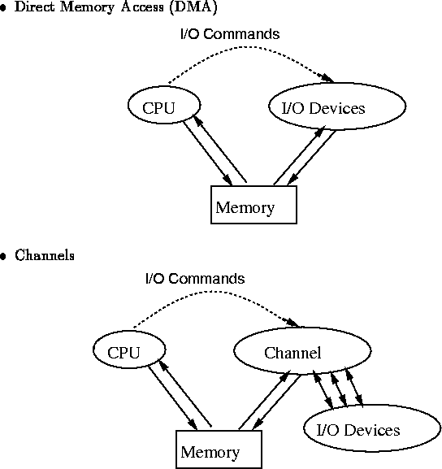
Speeding up I/O

Slide 35
Desirable Hardware Features
Memory protection for monitor
  Jobs cannot overwrite or alter
Timer
  Prevent a job from monopolizing system
Privileged instructions
  Only executed by the monitor
Interrupts
Notes:
The monitor, or batch operating system, is simply a computer program.
It relies on the ability of the processor to fetch instructions from various portions of main memory to alternately seize and relinquish control.
Certain other hardware features are also desirable:
Memory protection: While the user program is executing, it must not alter the memory area containing the monitor.
If such an attempt is made, the processor hardware should detect an error and transfer control to the monitor.
The monitor would then abort the job, print out an error message, and load in the next job.
Timer: A timer is used to prevent a single job from monopolizing the system.
The timer is set at the beginning of each job.
If the timer expires, the user program is stopped, and control returns to the monitor.
Privileged instructions: Certain machine level instructions are designated privileged and can be executed only by the monitor.
If the processor encounters such an instruction while executing a user program, an error occurs causing control to be transferred to the monitor.
Among the privileged instructions are I/O instructions, so that the monitor retains control of all I/O devices.
E.G. this prevents a user program from accidentally reading job control instructions from the next job.
If a user program wishes to perform I/O, it must request that the monitor perform the operation for it.
Interrupts: Early computer models did not have this capability.
This feature gives the OS more flexibility in relinquishing control to and regaining control from user programs.

Slide 36
Modes of Operation
User Mode
  User program executes in user mode
  Certain areas of memory protected from user access
  Certain instructions may not be executed
Kernel Mode
  Monitor executes in kernel mode
  Privileged instructions may be executed, all memory accessible.
Notes:
VIT University

Slide 37
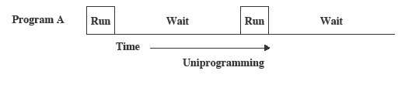
Uniprogramming ( Disk Operating System)
Processor must wait for I/O instruction to complete before preceding.
Notes:
VIT University

Slide 38
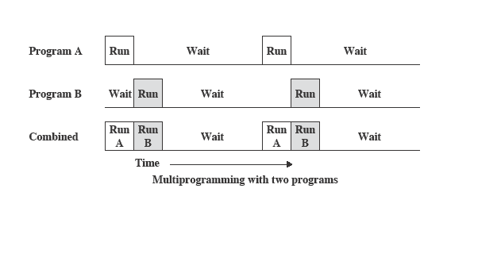
Multiprogramming
When one job needs to wait for I/O, the processor can switch to the other job.
Notes:
VIT University

Slide 39
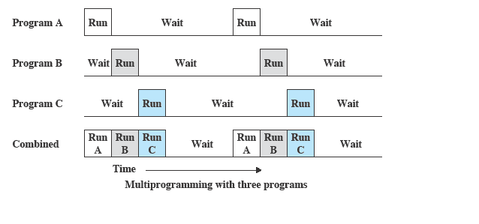
Multiprogramming
Notes:
VIT University

Slide 40
OS Features Needed for Multiprogramming
I/O routine supplied by the system.
Memory management – the system must allocate the memory to several jobs.
CPU scheduling – the system must choose among several jobs ready to run.
Allocation of devices.
Notes:
VIT University

Slide 41
Example:
UNIX, Linux
  Mac OS/X
  OS/2
  Windows XP, Vista, 2003/2008 Server
  Note: Windows 3.x is NOT an Operating System
Notes:
VIT University

Slide 42
Time Sharing Systems–Interactive Computing
Using multiprogramming to handle multiple interactive jobs
Processor’s time is shared among multiple users
Multiple users simultaneously access the system through terminals.
On-line communication between the user and the system is provided; when the operating system finishes the execution of one command, it seeks the next “control statement” from the user’s keyboard.
On-line system must be available for users to access data and code.
Notes:
VIT University

Slide 43
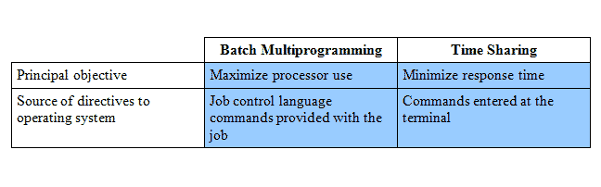

Batch Multiprogramming vs. Time Sharing
Notes:
VIT University

Slide 44
Early Example: CTSS
Compatible Time-Sharing System (CTSS)
  Developed at MIT as project MAC
Time Slicing:
  When control was passed to a user
  User program and data loaded
  Clock generates interrupts about every 0.2 sec
  At each interrupt OS gained control and could assign processor to another user.
Notes:
VIT University

Slide 45
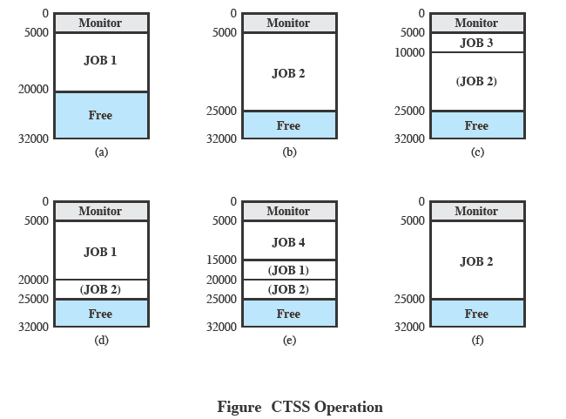
CTSS Operation
Notes:
VIT University

Slide 46
Problems and Issues
Multiple jobs in memory must be protected from each other’s data.
File system must be protected so that only authorised users can access.
Contention for resources must be handled
  Printers, storage etc
Notes:
VIT University

Slide 47
Desktop Systems
Personal computers – computer system dedicated to a single user.
I/O devices – keyboards, mice, display screens, small printers.
User convenience and responsiveness.
Can adopt technology developed for larger operating system’ often individuals have sole use of computer and do not need advanced CPU utilization of protection features.
May run several different types of operating systems (Windows, MacOS, UNIX, Linux)
Notes:
VIT University

Slide 48
Parallel Systems
Multiprocessor systems with more than one CPU in close communication.
Tightly coupled system – processors share memory and a clock; communication usually takes place through the shared memory.
Advantages of parallel system:
  Increased throughput
  Economical
  Increased reliability
    graceful degradation.
    fail-soft systems.
Notes:
VIT University

Slide 49
Parallel Systems Cont…
Symmetric multiprocessing (SMP)
  There are multiple processors.
  These processors share the same main memory and I/O facilities, interconnected by a communications bus or other internal connection scheme.
  All processors can perform the same functions (hence the term symmetric).
  Many processes can run at once without performance deterioration.
  Most modern operating systems support SMP.
Notes:
VIT University

Slide 50
Parallel Systems Cont…
Asymmetric multiprocessing
  Each processor is assigned a specific task; master processor schedules and allocated work to slave processors.
  More common in extremely large systems.

Slide 51

Symmetric Multiprocessing Architecture
Notes:
VIT University

Slide 52
SMP Advantages
Performance
  Allowing parallel processing
Availability
  Failure of a single process does not halt the system
Incremental Growth
  Additional processors can be added.
Scaling
Notes:
SMP has a number of potential advantages over uniprocessor architecture, including the following:
Performance:
If the work to be done by a computer can be organized so that some portions of the work can be done in parallel, then a system with multiple processors will yield greater performance than one with a single processor of the same type.
Availability: In a symmetric multiprocessor, because all processors can perform the same functions, the failure of a single processor does not halt the system.
Instead, the system can continue to function at reduced performance.
Incremental growth: A user can enhance the performance of a system by adding an additional processor.
Scaling: Vendors can offer a range of products with different price and performance characteristics based on the number of processors configured in the system.

Slide 53
Examples:
Example for SMP:
  Windows NT,Solaris ,Digital Unix,OS/2 And Linux
Example for ASMP:
  SunOSVersion 4
Notes:
VIT University

Slide 54
Distributed Systems
Distribute the computation among several physical processors.
Loosely coupled system – each processor has its own local memory; processors communicate with one another through various communications lines, such as high-speed buses or telephone lines.
Advantages of distributed systems.
  Resources Sharing
  Computation speed up – load sharing
  Reliability
  Communications
Notes:
VIT University

Slide 55
Distributed Systems (cont)
Requires networking infrastructure.
Local area networks (LAN) or Wide area networks (WAN)
May be either client-server or peer-to-peer systems.
Notes:
VIT University

Slide 56

General Structure of Client-Server
Notes:
VIT University

Slide 57
Clustered Systems
Clustering allows two or more systems to share storage.
Provides high reliability.
Asymmetric clustering: one server runs the application while other servers standby.
Symmetric clustering: all N hosts are running the application.
Notes:
VIT University

Slide 58
Real-Time Systems
Correctness of the system depends not only on the logical result of the computation but also on the time at which the results are produced.
Tasks or processes attempt to control or react to events that take place in the outside world.
Real-Time systems may be either hard or soft real-time.
Notes:
VIT University

Slide 59
Real-Time Systems Cont…
Hard real-time:
  Secondary storage limited or absent, data stored in short term memory, or read-only memory (ROM).
  Conflicts with time-sharing systems, not supported by general-purpose operating systems.
  One that must meet a deadline
Soft real-time
  Limited utility in industrial control of robotics.
  Useful in applications (multimedia, virtual reality) requiring advanced operating-system features.
  Has a deadline which is desirable but not mandatory
Notes:
VIT University

Slide 60
Real Time system Applications…
Robotics
Air traffic control
Telecommunications
Military command and control systems
controlling scientific experiments
medical imaging systems
industrial control systems
some display systems.
Notes:
VIT University

Slide 61
Features of Real-Time OS
Fast process or thread switch
Small size
Ability to respond to external interrupts quickly.
Multitasking with interprocess communication tools such as semaphores, signals, and events.
Use of special sequential files that can accumulate data at a fast rate.
Preemptive scheduling base on priority.
Minimization of intervals during which interrupts are disabled.
Special alarms and timeouts.
Delay tasks for fixed amount of time.
Notes:
VIT University

Slide 62
Handheld Systems
Personal Digital Assistants (PDAs)
Cellular telephones
Issues:
  Limited memory
  Slow processors
  Small display screens.
Notes:
VIT University

Slide 63

Migration of Operating-System Concepts and Features
Notes:
VIT University

Slide 64
Common System Components
Process Management
Main Memory Management
File Management
I/O System Management
Secondary Management
Networking
Protection System
Command-Interpreter System (Shell)
Notes:
VIT University

Slide 65
Process Management
A process is a program in execution. A process needs certain resources, including CPU time, memory, files, and I/O devices, to accomplish its task.
The operating system is responsible for the following activities in connection with process management.
  Process creation and deletion.
  process suspension and resumption.
  Provision of mechanisms for:
    process synchronization
    process communication
Notes:
VIT University

Slide 66
Main-Memory Management
Memory is a large array of words or bytes, each with its own address. It is a repository of quickly accessible data shared by the CPU and I/O devices.
Main memory is a volatile storage device. It loses its contents in the case of system failure.
The operating system is responsible for the following activities in connections with memory management:
  Keep track of which parts of memory are currently being used and by whom.
  Decide which processes to load when memory space becomes available.
  Allocate and deallocate memory space as needed.
Notes:
VIT University

Slide 67
I/O System Management
The I/O system consists of:
  A buffer-caching system .
  A general device-driver interface.
  Drivers for specific hardware devices
Notes:
VIT University

Slide 68
Secondary-Storage Management
Since main memory (primary storage) is volatile and too small to accommodate all data and programs permanently, the computer system must provide secondary storage to back up main memory.
Most modern computer systems use disks as the principle on-line storage medium, for both programs and data.
The operating system is responsible for the following activities in connection with disk management:
  Free space management
  Storage allocation
  Disk scheduling
Notes:
VIT University

Slide 69
Networking (Distributed Systems)
A distributed system is a collection processors that do not share memory or a clock. Each processor has its own local memory.
The processors in the system are connected through a communication network.
Communication takes place using a protocol.
A distributed system provides user access to various system resources.
Access to a shared resource allows:
  Computation speed-up
  Increased data availability
  Enhanced reliability
Notes:
VIT University

Slide 70
Protection System
Protection refers to a mechanism for controlling access by programs, processes, or users to both system and user resources.
The protection mechanism must:
  distinguish between authorized and unauthorized usage.
  specify the controls to be imposed.
  provide a means of enforcement.
Notes:
VIT University

Slide 71
Command-Interpreter System (shell)
Many commands are given to the operating system by control statements which deal with:
  process creation and management
  I/O handling
  secondary-storage management
  main-memory management
  file-system access
  protection
  networking
Notes:
VIT University

Slide 72
Command-Interpreter System Conti…
The program that reads and interprets control statements is called variously:
  command-line interpreter
  shell (in UNIX)
Its function is to get and execute the next command statement.
Notes:
VIT University

Slide 73
What is Shell
Command Interpreter that turns text that you type (at the command line) in to actions.
User Interface: take the command from user.
Shell Programming
  We often want to do a number of commands together.
  And bundle them up into one new command.
  Just like a batch file in MS-DOS

Slide 74
Popular Shells
sh Bourne Shell
ksh Korn Shell
bash Bourne-Again Shell
csh,tcsh C Shell
Note: Shell scripts among those shells are slightly different.
The Bourne shell. If you are using a Bourne-type shell, the default prompt is the $ character.
The C shell. If you are using a C-type shell, the default prompt is the % character.
Notes:
VIT University

Slide 75
User Operating System Interface - CLI
CLI allows direct command entry
    Sometimes implemented in kernel, sometimes by systems program
    Sometimes multiple flavors implemented – shells
    Primarily fetches a command from user and executes it
      Sometimes commands built-in, sometimes just names of programs
      If the latter, adding new features doesn’t require shell modification.

Slide 76
User Operating System Interface - GUI
User-friendly desktop metaphor interface
  Usually mouse, keyboard, and monitor
  Icons represent files, programs, actions, etc
  Various mouse buttons over objects in the interface cause various actions (provide information, options, execute function, open directory (known as a folder)
  Invented at Xerox PARC
Many systems now include both CLI and GUI interfaces
  Microsoft Windows is GUI with CLI “command” shell
  Apple Mac OS X as “Aqua” GUI interface with UNIX kernel underneath and shells available
  Solaris is CLI with optional GUI interfaces (Java Desktop, KDE)

Slide 77
System Calls
System calls provide the interface between a running program and the operating system.
  Generally available as assembly-language instructions.
  Languages defined to replace assembly language for systems programming allow system calls to be made directly (e.g., C, C++ & Perl )
Three general methods are used to pass parameters between a running program and the operating system.
  Pass parameters in registers.
  Store the parameters in a table/Block in memory, and the table address is passed as a parameter in a register.(Linux).
  Stack (Push & Pop)
  preferred: block/stack (Because don’t limit number or length of parameters being passed)
Notes:
VIT University

Slide 78

Passing of Parameters As A Table
  Push (store) the parameters onto the stack by the program, and pop off the stack by operating system.
Notes:
VIT University

Slide 79

Example of System Calls
System call sequence to copy the contents of one file to another file

Slide 80

Example of Standard API
Consider the ReadFile() function in the
Win32 API—a function for reading from a file
A description of the parameters passed to ReadFile()
  HANDLE file—the file to be read
  LPVOID buffer—a buffer where the data will be read into and written from
  DWORD bytesToRead—the number of bytes to be read into the buffer
  LPDWORD bytesRead—the number of bytes read during the last read
  LPOVERLAPPED ovl—indicates if overlapped I/O is being used

Slide 81
System Call Implementation
Typically, a number associated with each system call
  System-call interface maintains a table indexed according to these numbers
The system call interface invokes intended system call in OS kernel and returns status of the system call and any return values
The caller need know nothing about how the system call is implemented
  Just needs to obey API and understand what OS will do as a result call.
  Most details of OS interface hidden from programmer by API
    Managed by run-time support library (set of functions built into libraries included with compiler)

Slide 82

API – System Call – OS Relationship

Slide 83

Standard C Library Example
C program invoking printf() library call, which calls write() system call

Slide 84
Types of System Calls
Process control
File management
Device management
Information maintenance
Communications
Unix system calls
  read(), write(), open(), close(), fork(), exec(), ioctl(),…..
Notes:
VIT University

Slide 85
Types of System Calls Conti…
Process Control.
  Execute
  load
  create process
  terminate process
  get/set process attributes
  wait for time, wait event, signal event
  allocate, free memory

Slide 86
Types of System Calls Conti…
File management.
  create file, delete file
  open, close
  read, write, reposition
  get/set file attributes

Slide 87
Types of System Calls Conti…
Device Management.
request device, release device
read, write, reposition
get/set device attributes
logically attach or detach devices

Slide 88
Types of System Calls Conti…
Information Maintenance.
  get/set time or date
  get/set system data
  get/set process, file, or device attributes

Slide 89
Types of System Calls Conti…
Communication.
  create, delete communication connection
  send, receive messages
  transfer status information
  attach or detach remote devices

Slide 90
Fork() System call
System call fork() is used to create processes.
It takes no arguments and returns a process ID.
    If fork() returns a negative value, the creation of a child process was unsuccessful.
    fork() returns a zero to the newly created child process.
    fork() returns a positive value, the process ID of the child process, to the parent.
    The purpose of fork() is to create a new process, which becomes the child process of the caller. After a new child process is created, both processes will execute the next instruction following the fork() system call.
Notes:
VIT University

Slide 91
Fork ( ) System call conti…
Some diﬀerences between the child and parent process are:
  in the child, fork( ) always returns 0
  separate copies of all data, including variables with their current values and the stack
  separate program counter (PC) indicating where to execute next; originally both have the same value but they are thereafter separate
  after fork, the two processes do not share variables
  Diﬀerent pids
  in the parent, fork( ) returns the pid of the child process if a child process is created
Notes:
VIT University

Slide 92
Hardware Protection
Dual Mode Operation
I/O Protection
Memory Protection
CPU Protection

Slide 93
Dual-mode operation
Sharing system resources requires operating system to ensure that an incorrect program cannot cause other programs to execute incorrectly.
Provide hardware support to differentiate between at least two modes of operation:
  User mode : Execution done on behalf of a user.
  Monitor mode (supervisor/kernel/system mode) : Execution done on behalf of operating system.

Slide 94
Dual-mode operation cont…
Mode bit added to computer hardware to indicate the current mode: monitor(0) or user(1).
When an interrupt or fault occurs, hardware switches to monitor mode.
Privileged instructions only in monitor mode.
User
Interrupt/
fault
Set
user
mode
Monitor
Notes:
VIT University

Slide 95

Transition from User to Kernel Mode
Timer to prevent infinite loop / process hogging resources
  Set interrupt after specific period
  Operating system decrements counter
  When counter zero generate an interrupt
  Set up before scheduling process to regain control or terminate program that exceeds allotted time

Slide 96
I/O Protection
All I/O instructions are privileged instructions.
Must ensure that a user program could never gain control of the computer in monitor mode.
Example: a user program that as part of its execution, stores a new address in the interrupt vector.

Slide 97
Memory Protection
Must provide memory protection at least for the interrupt vector and the interrupt service routines.
To provide memory protection, add two registers that determine the range of legal addresses a program may address.
  Base Register - holds smallest legal physical memory address.
  Limit register - contains the size of the range.
Memory outside the defined range is protected.
0
0
monitor
256000
Job1
Base register
3000040
300040
Job 2
420940
120900
Job 3
Limit register
880000
Job 4
1024000

Slide 98
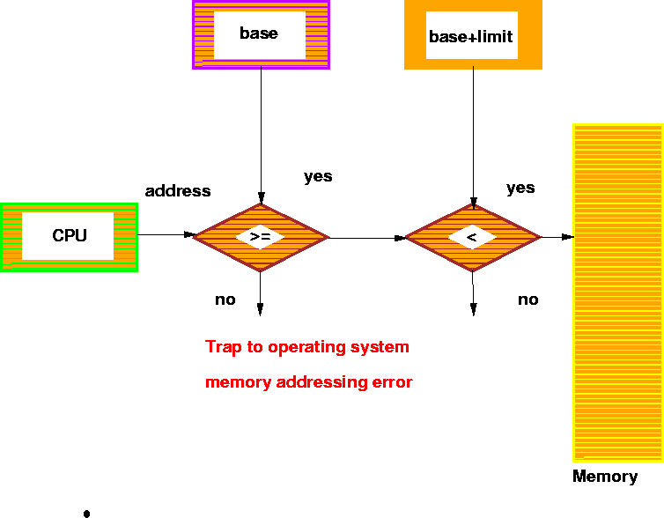
Hardware Address Protection

Slide 99
Protection Hardware cont…
When executing in monitor mode, the OS has unrestricted access to both monitor and users’ memory.
The load instructions for the base and limit registers are privileged instructions.

Slide 100
CPU Protection
Timer - interrupts computer after specified period to ensure that OS maintains control.
  Timer is decremented every clock tick.
  When timer reaches a value of 0, an interrupt occurs.
Timer is commonly used to implement time sharing.
Timer is also used to compute the current time.
Load timer is a privileged instruction.

Slide 101
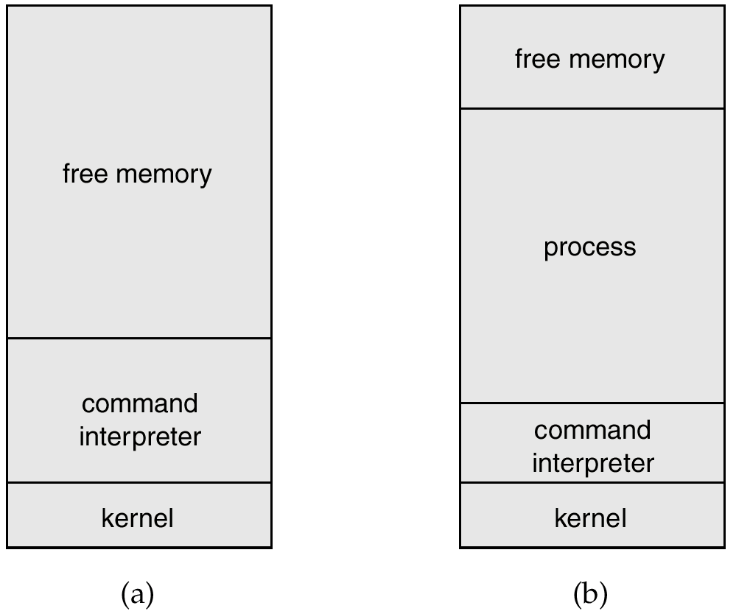
MS-DOS Execution
At system start up Running a program
Notes:
VIT University

Slide 102
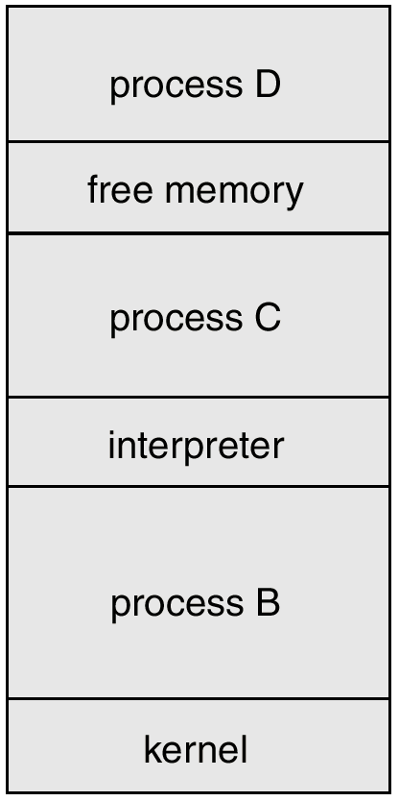
UNIX Running Multiple Programs
Notes:
VIT University

Slide 103

Communication Models
Communication may take place using either message passing or shared memory.
Msg Passing
Shared Memory
Notes:
VIT University

Slide 104
System Programs
System programs provide a convenient environment for program development and execution. The can be divided into:
  File manipulation
  Status information
  File modification
  Programming language support
  Program loading and execution
  Communications
  Application programs
Most users’ view of the operation system is defined by system programs, not the actual system calls.
Notes:
VIT University

Slide 105
MS-DOS System Structure
MS-DOS – written to provide the most functionality in the least space
  not divided into modules.
  Although MS-DOS has some structure, its interfaces and levels of functionality are not well separated
Notes:
VIT University

Slide 106

MS-DOS Layer Structure
Notes:
VIT University

Slide 107
UNIX System Structure
UNIX – limited by hardware functionality, the original UNIX operating system had limited structuring. The UNIX OS consists of two separable parts.
  Systems programs
  The kernel
    Consists of everything below the system-call interface and above the physical hardware
    Provides the file system, CPU scheduling, memory management, and other operating-system functions; a large number of functions for one level.
Notes:
VIT University

Slide 108
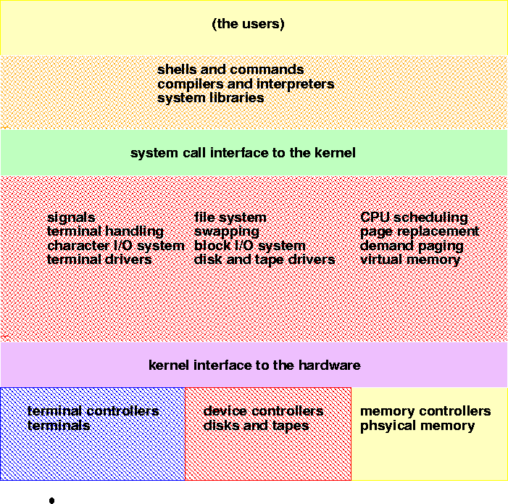
UNIX System Structure

Slide 109
Layered Approach
The operating system is divided into a number of layers (levels), each built on top of lower layers. The bottom layer (layer 0), is the hardware; the highest (layer N) is the user interface.
With modularity, layers are selected such that each uses functions (operations) and services of only lower-level layers.
Notes:
VIT University

Slide 110
Unix Architecture
Notes:
VIT University

Slide 111

An Operating System Layer
Notes:
VIT University

Slide 112
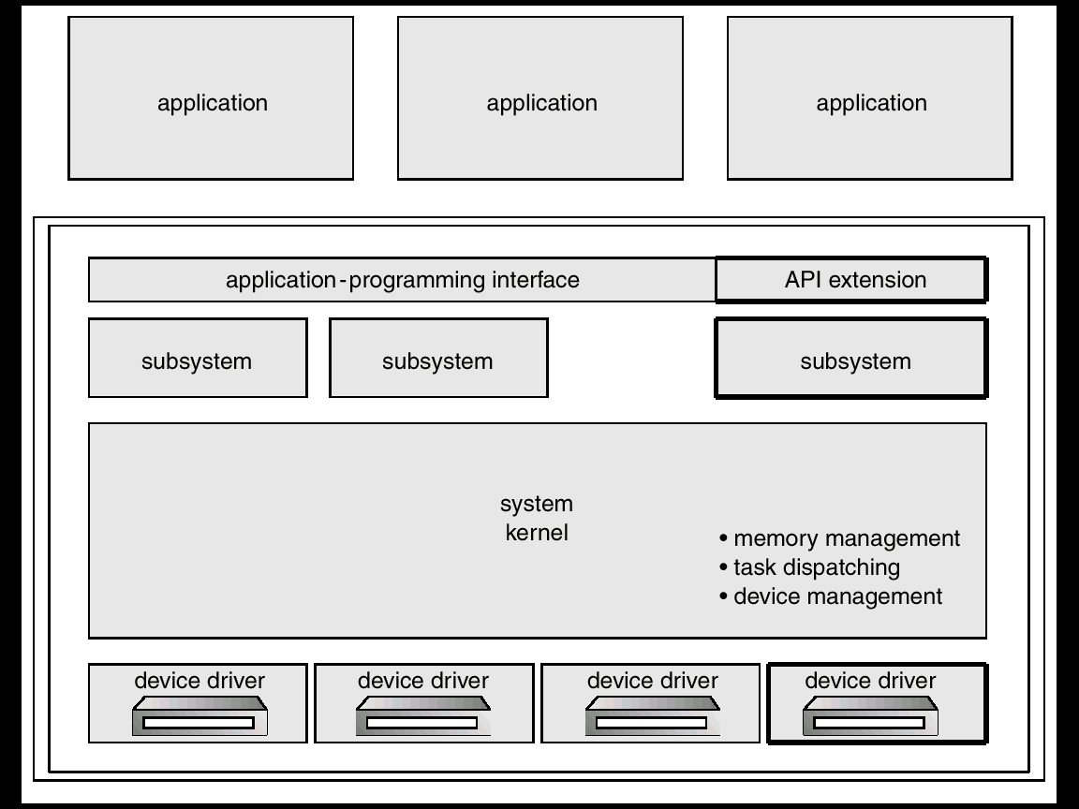
OS/2 Layer Structure
Notes:
VIT University

Slide 113
Microkernel System Structure
Moves as much from the kernel into “user” space.
Communication takes place between user modules using message passing.
Benefits:
  easier to extend a microkernel
  easier to port the operating system to new architectures
  more reliable (less code is running in kernel mode)
  more secure.
Notes:
VIT University

Slide 114

Windows NT Client-Server Structure
Notes:
VIT University

Slide 115
Virtual Machines
A virtual machine takes the layered approach to its logical conclusion. It treats hardware and the operating system kernel as though they were all hardware.
A virtual machine provides an interface identical to the underlying bare hardware.
The operating system creates the illusion of multiple processes, each executing on its own processor with its own (virtual) memory.
Notes:
VIT University

Slide 116
Virtual Machines Cont…
The resources of the physical computer are shared to create the virtual machines.
  CPU scheduling can create the appearance that users have their own processor.
  Spooling and a file system can provide virtual card readers and virtual line printers.
  A normal user time-sharing terminal serves as the virtual machine operator’s console.
Notes:
VIT University

Slide 117

System Models
Non-virtual Machine
Virtual Machine
Notes:
VIT University

Slide 118
Advantages/Disadvantages of Virtual Machines
The virtual-machine concept provides complete protection of system resources since each virtual machine is isolated from all other virtual machines. This isolation, however, permits no direct sharing of resources.
A virtual-machine system is a perfect vehicle for operating-systems research and development. System development is done on the virtual machine, instead of on a physical machine and so does not disrupt normal system operation.
The virtual machine concept is difficult to implement due to the effort required to provide an exact duplicate to the underlying machine.
Notes:
VIT University

Slide 119
Java Virtual Machine
Compiled Java programs are platform-neutral byte codes executed by a Java Virtual Machine (JVM).
JVM consists of
  class loader
  class verifier
  runtime interpreter
Just-In-Time (JIT) compilers increase performance
Notes:
VIT University

Slide 120

The Java Virtual Machine Cont….

Slide 121
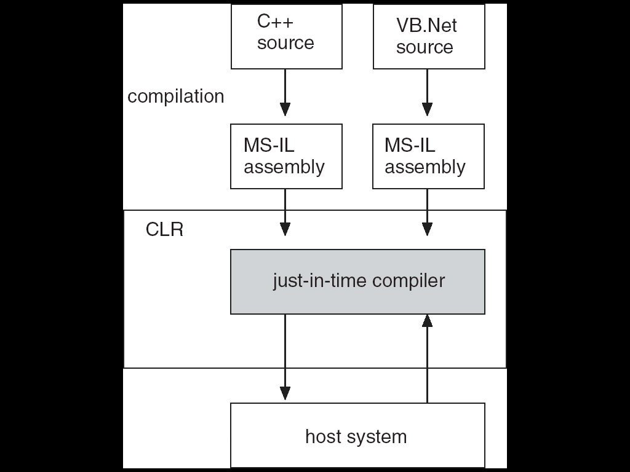
The Java Virtual Machine Cont….

Slide 122

Java Virtual Machine Conti…
Notes:
VIT University

Slide 123
System Design Goals
User goals – operating system should be convenient to use, easy to learn, reliable, safe, and fast.
System goals – operating system should be easy to design, implement, and maintain, as well as flexible, reliable, error-free, and efficient.
Notes:
VIT University

Slide 124
Mechanisms and Policies
Mechanisms determine how to do something, policies decide what will be done.
The separation of policy from mechanism is a very important principle, it allows maximum flexibility if policy decisions are to be changed later.
Notes:
VIT University

Slide 125
System Implementation
Traditionally written in assembly language, operating systems can now be written in higher-level languages.
Code written in a high-level language:
    can be written faster.
    is more compact.
    is easier to understand and debug.
An operating system is far easier to port (move to some other hardware) if it is written in a high-level language.
Notes:
VIT University

Slide 126
System Generation (SYSGEN)
Operating systems are designed to run on any of a class of machines; the system must be configured for each specific computer site.
SYSGEN program obtains information concerning the specific configuration of the hardware system.
Booting – starting a computer by loading the kernel.
Bootstrap program – code stored in ROM that is able to locate the kernel, load it into memory, and start its execution.
Notes:
VIT University

Slide 127

Thank you
Notes:
VIT University

